Slide 1
Education for Sustainability

Slide 2
Introductions
INSERT YOURS HERE

Slide 3
Ice breaker
INSERT YOURS HERE

Slide 4
The plan
INSERT YOURS HERE

Slide 5
Let’s get started!

Slide 6
Film 1 – project intro

Slide 7
Film 2 – what is sustainability?

Slide 8
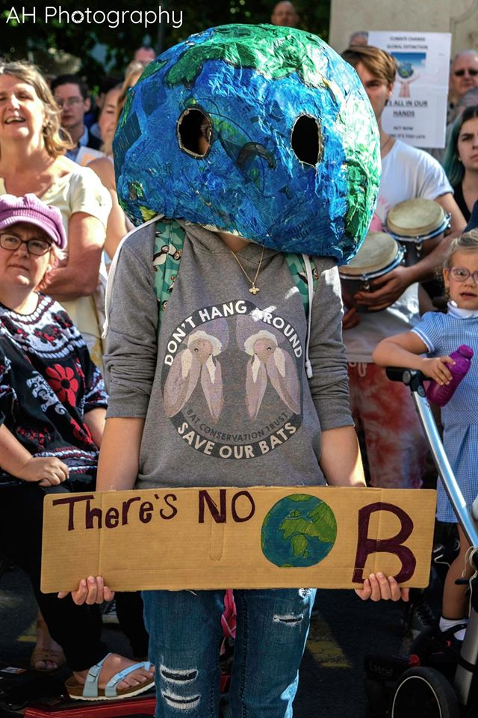
What are students saying about sustainability?
91% of students are fairly or very concerned about climate change (SOS UK 2021)
55% of Millennials and Gen Z worry about the climate on a weekly basis (Interface 2017)
95% of young leaders think business is not doing enough (Interface 2017)
68% of students want government to prioritise the climate in recovery after Covid 19 (SOS UK 2020)
Notes:
Across all ages groups there is increased expectation of action: with 64% of people worldwide view climate change as a global emergency (People’s Climate Vote 2021) but this is more pronounced among younger people.

Slide 9
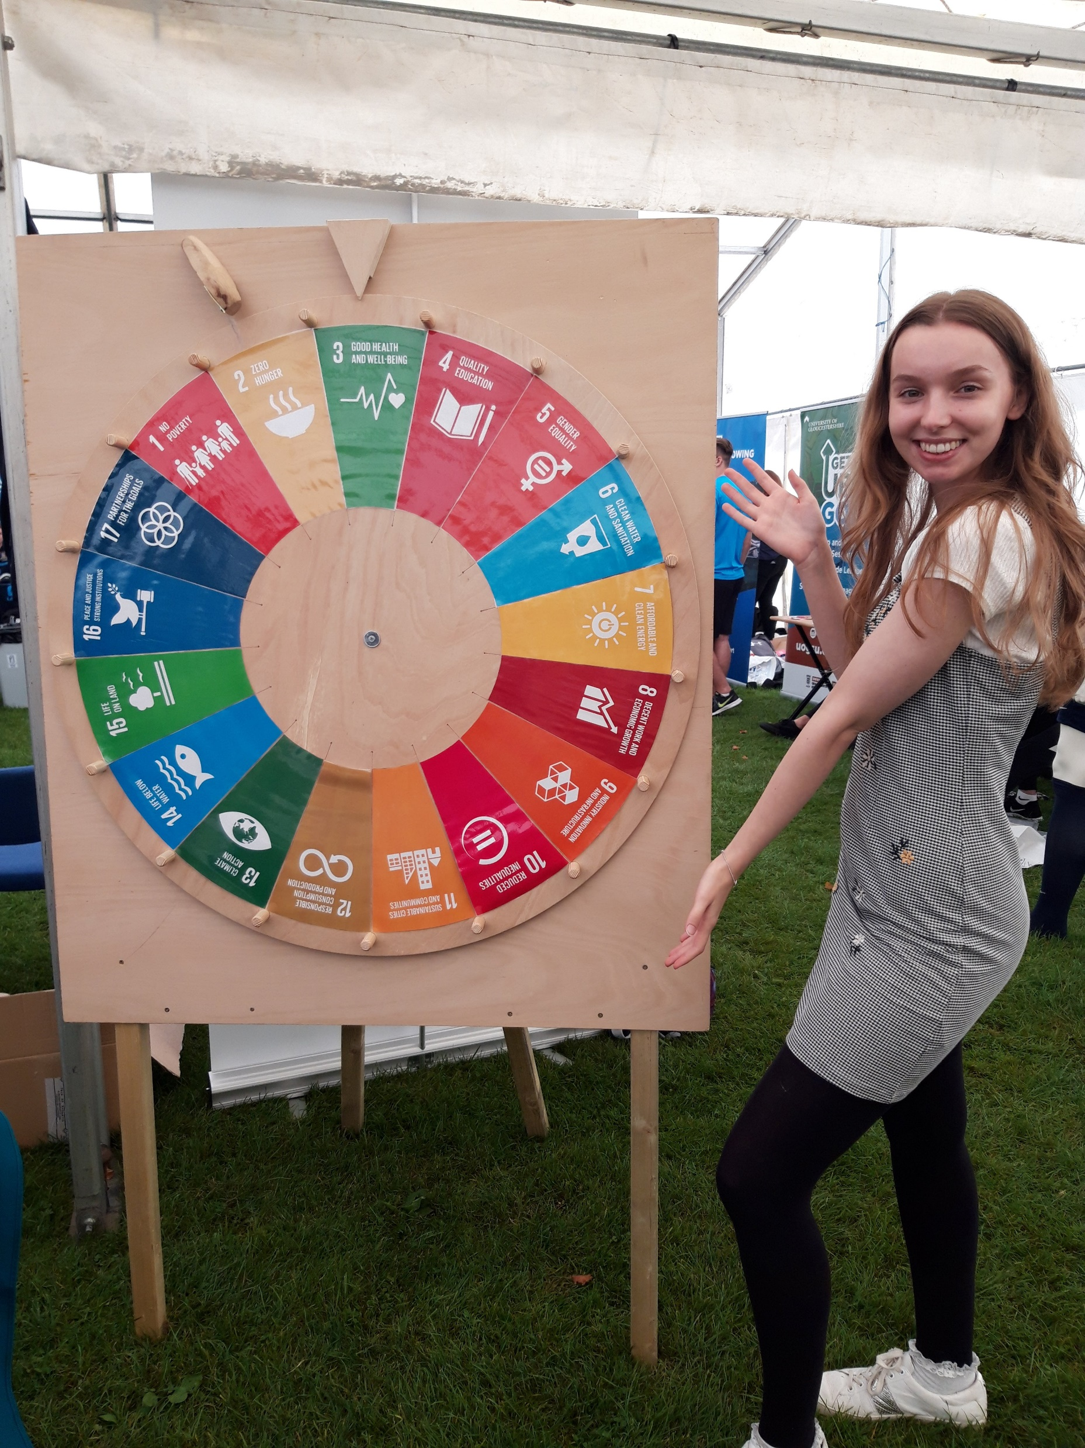
What are students saying about sustainability?
91% of young leaders think ‘climate take back’ is possible (Interface 2017)
Over half of Gen Z are relentlessly committed to making sure change happens (Beatfreaks 2021)
Personal responsibility, consumer behaviour and life choices seen as key to change (Deloitte 2020)
87% of Gen Z pay attention to brand ethics and 53% expect to see organisations visibly active on sustainability issues (Beatfreaks 2021)
Notes:
Students and young people aren’t just concerned for global issues, they hold optimism and want to lead change.
Appetite was evident pre-Covid 19, but in light of the reduced pollution seen due to the pandemic, Millennials and Gen Z are increasingly hopeful that there is still time to protect the planet:

Slide 10
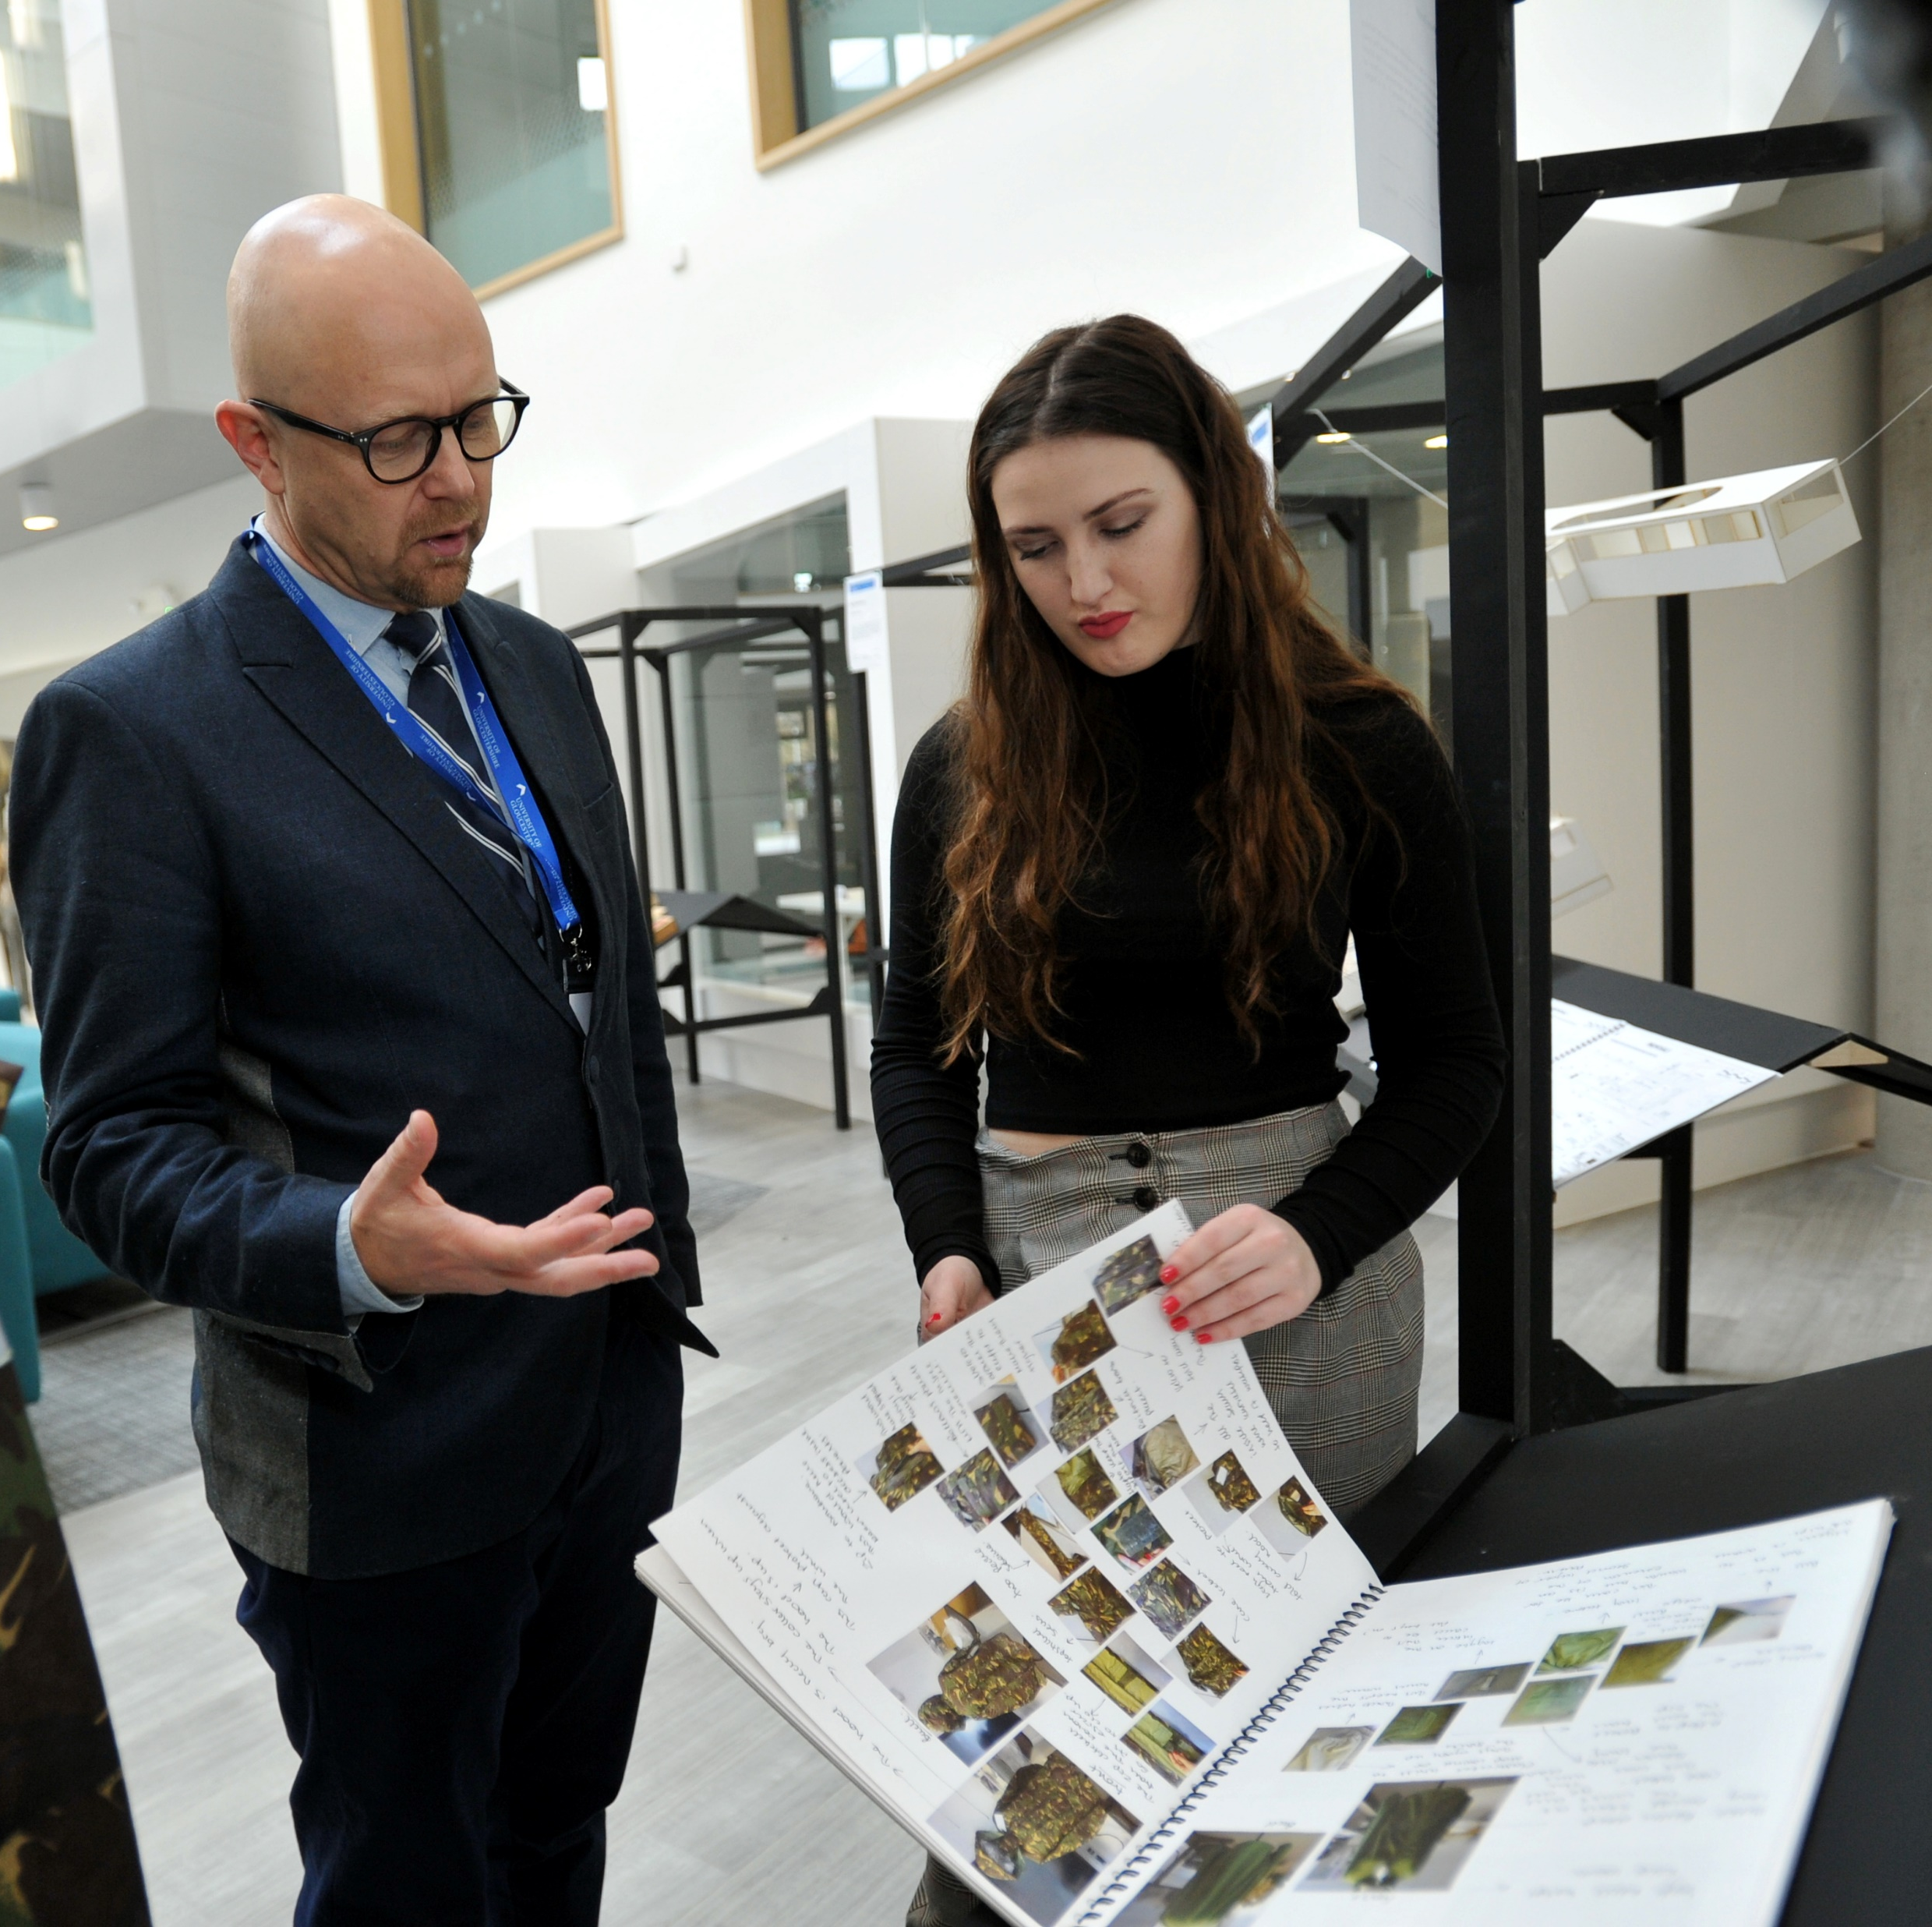
What are students saying about sustainability?
91% of UK students think universities should incorporate and promote sustainability (SOS UK 2020)
96% desire visible sustainability action such as energy saving and locally sourced food (Shift 2021)
83% of UK students think sustainability should be incorporated into all courses and 83% identify work experience and placements as the most relevant way to do this (SOS UK 2020).
Notes:
A number of UK studies show sustainability is now more significant to prospective students than nightlife opportunities (SOS UK 2020) and location (THE 2021). This trend is echoed in other countries e.g. 78% of French students view a sustainability-focused university more favourably (REFEDD 2020).
Once students arrive at university expectations around sustainability remain high. Students recognise this is not just ‘greening the campus’ and want sustainability as core to educational and professional experiences

Slide 11
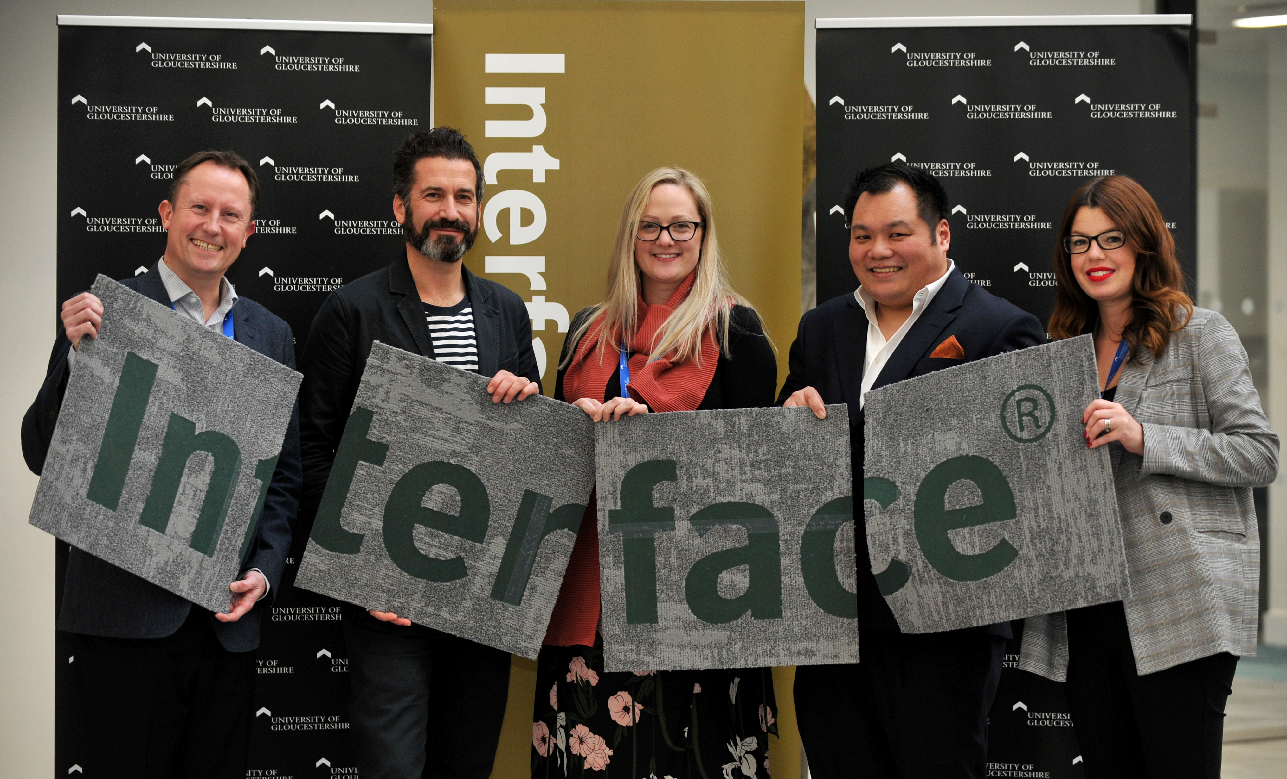
What are employers saying about sustainability?
Net zero carbon need new skills and jobs
The current labour force has big gaps
89% of finance staff, 74% of product development staff and 82% of procurement staff, were not fully capable of contributing to their organisations’ environment and sustainability agendas (IEMA 2015)
Notes:
78% of UK adults want to play a part in reaching the UK’s net zero carbon goal and 57% want to work for an organisation that helps the UK get there (Aldersgate Group 2020)
The 4th industrial revolution opens opportunities in sustainability and net zero emissions, but there remains a strong need for skills that appreciate the environmental and social value at stake in potential investment decisions (BITC 2016).

Slide 12
Film 3 – what is the role of education?

Slide 13
Film 4 – what skills does good Education for Sustainability give you?

Slide 14
Futures Thinking – an industry example

Slide 15
Film 5 – Quality sustainability learning and spotting greenwash
Notes:
So what’s good quality sustainability learning?
And what’s greenwash?
Maybe here ask the group the question – what do they think greenwash is?
Take some answers then explain:
Greenwash is the process of conveying a false impression or providing misleading information about how environmentally sound something is. Although some of the environmental claims might be partly true, greenwash exaggerates or does not provide the whole picture.
In education, greenwash might be claimed that ‘100% of courses have sustainability learning’ but actually this might just be from the keywords in course promotions mentioning one global goal – no joined-up learning that links in with the planet. Or the course claimed to have sustainability but the reality didn’t live up to the promise.

Slide 16
Quality principles
Joined up sustainability learning
In a compulsory module
‘From first year to final year’
Assessed is best

Slide 17
Events Management example

Slide 18
Film 6 – how to rate your course
Notes:
See the anti-greenwash education kit for details for the final rating criteria:

Slide 19
Let’s practice!

Slide 20
Business module – level 4 [this module is compulsory]
Students are introduced to the workings of the global music industries. Students are introduced to the global goals framework and the concept of the triple bottom line, and encouraged to think about how they can apply the goals as within the music business.

Slide 21
Business module – level 4 [this module is compulsory]
Students are introduced to the workings of the global music industries. Students are introduced to the global goals framework and the concept of the triple bottom line, and encouraged to think about how they can apply the goals as within the music business.
Bronze

Slide 22
Postgraduate programme in Education
Students attend a compulsory session with Education for Sustainability (EfS) focused content. They take part in class exercises requiring them to actively apply EfS thinking, and discuss and evaluate best EfS practice - but these exercises are not formally assessed.

Slide 23
Postgraduate programme in Education
Students attend a compulsory session with Education for Sustainability (EfS) focused content. They take part in class exercises requiring them to actively apply EfS thinking, and discuss and evaluate best EfS practice - but these exercises are not formally assessed.
Silver

Slide 24
Sport module – level 5 [this module is compulsory]
Students look at how sport is used for international development. They look at a range of sporting organisations and their response to development needs in the context of issues like influencing social justice, equality or wellbeing.

Slide 25
Sport module – level 5 [this module is compulsory]
Students look at how sport is used for international development. They look at a range of sporting organisations and their response to development needs in the context of issues like influencing social justice, equality or wellbeing.
No medal

Slide 26
Architecture course
Sustainability is very strong and clear in both the module content and assessment at level 4, 5 and 6 of this course. Students can see the relationships between people, the environment and economy. Students work on live briefs with industry partners – critically addressing sustainability through a strong employability focus.

Slide 27
Architecture course
Sustainability is very strong and clear in both the module content and assessment at level 4, 5 and 6 of this course. Students can see the relationships between people, the environment and economy. Students work on live briefs with industry partners – critically addressing sustainability through a strong employability focus.
Gold

Slide 28
Now rate your course

Slide 29
Further information
Anti-greenwash education kit
Project website:
glos.ac.uk/qualityefs

